Slide 1
Names 101 – Intro to name rules
Presented by
Yehuda ben Moshe
Elmet Herald
Notes:
This is

Slide 2
Introduction
Types of names
Personal (PN)
Non-Personal (NPN)
SCA Branches
Heraldic Titles
Award Orders
Households
Non-personal names not covered in this class, but many things in common
Notes:
Sections will be run over Google Hangouts and live at selected events

Slide 3
Period
GP3A: Definition of Period - Time
Generally before 1600
The period 1600-1650 is known as the “grey period”
Elements will usually be allowed
No official beginning time, but must be from cultures known to Medieval and Renaissance Europe
Classical Greek and Roman elements are acceptable
Elements from Pharaonic Egypt are not acceptable
Notes:
Gray Period is based on the idea that something found in that time probably existed earlier
Exception to Gray Period include elements we know were not created until after 1600
1650 is a hard cutoff.

Slide 4
Period
GP3B: Definition of Period – Place
Any part of Europe is always allowed
Names from other cultures that had contact with period Europe are allowed for people and households
Not allowed for SCA Branches
Notes:
Europe generally goes as far east as Russia, as far south as Greece, Italy, and Spain, but probably does not include Muslim Spain or the Middle East

Slide 5
Definitions
Given Name
Main personal name
Usually given at birth or naming ceremony
The modern “First Name” is a given name
Some cultures allow multiple given names
Such as modern “middle” name

Slide 6
Definitions
Byname
Part of the name other than a given name
Different cultures had different types of bynames
Not all cultures had all types of bynames
Modern “last name” is a type of byname, specifically an “inherited surname”
Different types of bynames described in detail in SENA Appendix B

Slide 7
Definitions
Types of Bynames
Locative
Describes where the person if from
Can be marked
“of York”
“de Marseilles”
“von Hamburg”
Can be unmarked
“Jack London”

Slide 8
Definitions
Types of Bynames
Patronymic
Formed from the person’s father’s name
Some of the earliest and most common bynames
Can be marked
“Nialsdottir”
“Johnsson”
“Petrovich”
Can be unmarked
“John Henry”
Occasionally, matronymics (mother’s name) were used

Slide 9
Definitions
Types of Bynames
Descriptive
Formed from a distinguishing characteristic
“the Tall”
“Grosse”
“gullskeggr”
Notes:
English, German (great), Norse (Gold Beard)

Slide 10
Definitions
Types of Bynames
Occupational (type of Descriptive bynames)
Describes the person’s occupation
“Draper”
“Guerrero”
“Sardello”
Notes:
English, Spanish (soldier), Italian (Sardines)

Slide 11
Definitions
Types of Bynames
Congnomento, alias, or dictus
A second given name the person goes by
“Iohannes dictus John”
Inherited
Clan names
Ó Conchobhair (masculine)
inghean Uí Chonchobhair (feminine)
Inherited surname
Basically the modern “last” name

Slide 12
Definitions
Name Phrase
A complete given name or byname, including all associated prepositions, articles, and requirements
Naming Pool
A group of name phrases that are in use in a particular place and time
Regional Naming Group
A group of naming pools that are culturally linked

Slide 13
Rules
To be registerable, the following must be met:
Each name phrase must be acceptable (PN1)
The combination of name phrases must be acceptable (PN2)
The name must be free of:
conflict (PN3)
presumption (PN4)
offense (PN5)

Slide 14
Rules – Name Phrases
Single Place and Time (PN1B1)
A Name Phrase must be internally consistent as to grammar and structure for a single time and place
A Name Phrase may not mix languages unless such a mix is attested
Example
“von Saxony” – No
“von Sachsen” – Ok
“of Saxony” - Ok
Notes:
“von Saxony” uses a German “von” with an English version of the German place name

Slide 15
Rules – Name Phrases
Sources of Name Phrases
Attested (PN1B2a)
A name phrase is considered attested if the complete name phrase is found in an acceptable source
Minor spelling variants that are demonstrated to be compatible with the spelling conventions of the name and place are allowed
In Renaissance English, “i“ and “y” were interchangeable, so the attested name “Annis” can also be spelled “Annys”
A single period example of an attested name phrase is enough for registration

Slide 16
Rules – Name Phrases
Sources of Name Phrases
Constructed (PN1B2b)
A name phrase can be constructed using a period pattern of name construction
Three documented examples of the desired pattern are generally required for registration
Dimunitives
In some languages created by adding or removing an ending
For example, in Italian, “Urbanino” can be constructed from “Urbano”

Slide 17
Rules – Name Phrases
Sources of Name Phrases
Constructed (PN1B2b)
Dithemic (two-part) names can be constructed from one prototheme and one deuterotheme
Can’t use any other combinations
Example
The attested Old English “Ælfgar” has the prototheme “Ælf-” and the deuterotheme “-gar”
The attested Old English “Eadmund” has the prototheme “Ead-” and the deuterotheme “-mund”
Therefore “Ælfmund” is a valid constructed name
“Garmund”, “Ælfead”, and “Ælfgarmund” are not
Notes:
Prototheme is the first part of a dithemic name, deuterotheme is the second part

Slide 18
Rules – Name Phrases
Sources of Name Phrases
Constructed (PN1B2b)
Bynames constructed from given name elements For names such as patronymics
Example
In Old Norse, standard patronymic for men consists of the possessive form of the father’s name plus the word “son”
From the attested given name “Bjartmarr” one can created the patronymic byname “Bjartmarsson”
Notes:
This pattern already documented in books.

Slide 19
Rules – Name Phrases
Sources of Name Phrases
Constructed (PN1B2b)
New place names can be constructed from attested elements
Example
“Oxford”, “Swinford” and “Hartford” are attested English place names
The pattern is “large hooved animal” + “-ford”
This would allow the construction of “Sheepford”
This would not allow “Bookford” or “Duckford”

Slide 20
Rules – Name Phrases
Sources of Name Phrases
Lingua Anglica Allowance(PN1B2c)
Allows translation of name phrase into standard modern English
Applies to attested or constructed descriptive, occupational, and locative bynames
Preserves the meaning for the benefit of modern speakers

Slide 21
Rules – Name Phrases
Sources of Name Phrases
Lingua Anglica Allowance(PN1B2c)
Must be a literal and plausible translation
The Norse “inn rauði” can be translated as “the Red”
Cannot be translated as “the bloody”, “the scarlet”, etc.

Slide 22
Rules – Name Phrases
Sources of Name Phrases
Lingua Anglica Allowance(PN1B2c)
For locatives, must be the standard modern English version of the name
While “Cairo” is derived from “the victorious”, the lingua Anglica form is “of Cairo”, not “of The Victorious”
“al-Qahira” is the Egyptian spelling, but “of al-Qahira” is not allowed as lingua Anglica, since the standard English form is “of Cairo”
This rule may not be used to translate the meanings of given names or place names

Slide 23
Rules – Name Phrases
Sources of Name Phrases
Borrowed Names (PN1B2d)
Name phrases may be borrowed from
Secular literature
The Bible
Other Religious Literature
Names of Saints
Must be linguistically appropriate
For example, the Arthurian character “Lancelot” is found in Italian as “Lancilotto”, therefore, “Lancilotto” is the form allowed in an Italian context

Slide 24
Rules – Name Phrases
Sources of Name Phrases
Borrowed Names (PN1B2d)
Must fit within a pattern of borrowing names
Evidence of borrowing given names does not support borrowing bynames
Evidence of borrowing names of major characters doesn’t support borrowing names of minor characters
Evidence of borrowing from one type of literature doesn’t support borrowing from another type

Slide 25
Rules – Name Phrases
Sources of Name Phrases
Legal Name Allowance (PN1B2e)
An element from the submitter’s legal name may be used
Must provide proof of the name
Must be exact same form and spelling as in legal name
Must be used in the same manner
Given name as given name
Surname as surname
Middle names vary
Must meet all other rules
May not be obtrusively modern
Notes:
“Smith” doesn’t justify “the Smith”
Middle names vary based on whether its source is a given name (period or original) or surname

Slide 26
Rules – Name Phrases
Sources of Name Phrases
Branch Name Allowance (PN1B2f)
Can always use “of Branchname” as a byname
Must use exact spelling, grammar, and language as in registered SCA branch name
“of the East” – Ok
“von Osten” – No
Can only use the Lingua Anglica “of”
“of Fontaine dans Sable” – Ok
“de Fontaine dans Sable” - No
Households are not branches

Slide 27
Rules – Name Phrases
Sources of Name Phrases
Grandfather Clause (PN1B2g)
Name phrases previously registered to an individual may be registered again, even if not currently registerable
May not allow one to evade new problems, only existing ones
Can also be used by close legal relative, with proof or attestation of the relationship

Slide 28
Rules – Name Phrases
Finding Attested Name Phrases
Articles on heraldry.sca.org and s-gabriels.org
Books of period names
Dated forms
Spelling not normalized
Period documents
FamilySearch

Slide 29
Rules – Construction
All registerable personal names must contain a given name and at least one byname (PN2B)
Single given names, though period, aren’t registerable
Each name phrase must be grammatically correct for its position in the name
“Fearchar” is a Gaelic given name
Becomes “mac Fearchair” (m) or “mhic Fhearchair” (f)
Notes:
If you really want a single name, register “John of Branchname” and just use “John”

Slide 30
Rules – Construction
Culturally uniform names (PN2C1)
A name which matches a pattern of the grammar of names for a single time and place
For example: “14C England”
Must use an overall pattern documented to that time and place
See Appendix A
All name phrases must be from the time and place to be considered uniform names

Slide 31
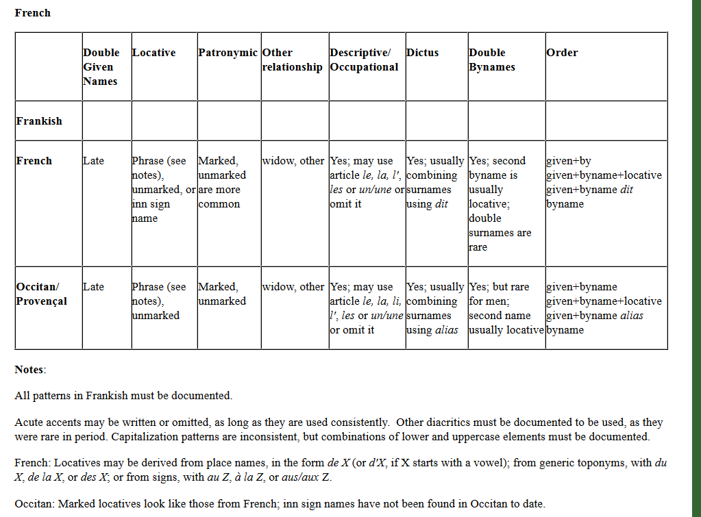
Rules – Construction
Appendix A
Notes:
For example: Francois le Tailor de Paris is ok – given + byname (occuputional) + locative
But not Francois le Tailor the Red – two bynames but don’t meet any of the patterns
To use a non-Appendix A pattern, must document it.

Slide 32
Rules – Construction
Culturally mixed names (PN2C2)
If all name phrases are from the same regional naming group (See Appendix C), they must be dated within 500 years of one other
If the name phrases are from two regional naming groups listed as compatible in Appendix C, they must be dated within 300 years of one another

Slide 33
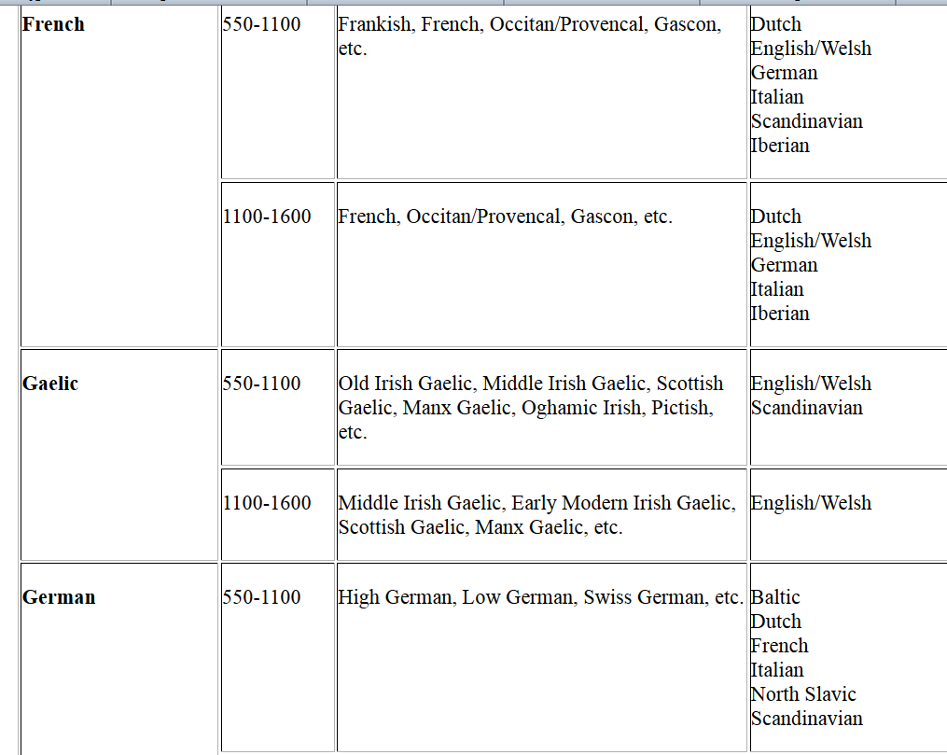
Rules – Construction
Appendix C

Slide 34
Rules – Construction
Culturally mixed names (PN2C2)
For non-Appendix C combinations, must document
If all name phrases are from naming pools which can be documented as being used together in personal names of real people, they must be dated within 300 years of one another
At least three period examples must be provided of a names combining the phrase pools
Notes:
Russian-scandinavan example

Slide 35
Rules – Construction
Culturally mixed names (PN2C2)
If a name phrase is documented under the legal name allowance, branch name allowance, or grandfather clause, it’s treated as neutral in language and time
May be combined with name phrases from a single regional naming group dated within 500 years of one another
May not be combined with name phrases from two or more regional naming groups
Notes:
Juliean – legal name + Smith – attested English is ok
Juliean Smith le Tailor is not – can’t do legal allowance + English + French

Slide 36
Rules – Construction
Names In Non-Latin Scripts (PN2D)
Only names in a Latin script are registerable
Names originally in other scripts must be transliterated
Russian, Japanese, Arabic, Norse runes, etc.
Must be transcribed using any standard transliteration system
Many are listed in Appendix D

Slide 37
Rules – Construction
Names In Non-Latin Scripts (PN2D)
Must use a single system for all name elements
Example
In Arabic, “Amina al-Hamadaniyya” or “Aminah al-Hamadaniyyah” – Ok
“Aminah al-Hamadaniyya” – No
Either use all the funny characters and accents, or none
In Gaelic, “Tomás Mór” or “Tomas Mor” – Ok
“Tomás Mor” or “Tomas Mór” - No

Slide 38
Rules – Obtrusive Modernity
Names that are obtrusively modern are not permitted (PN2E)
Joke names are acceptable
“Drew Steele”, “Mould de Cheder”, “Hillarius Drunk”
Names that “yank the reader out of a medieval mindset and into a modern or fantasy mindset” are not
“Porsche Audi”, “Artemisian Tank Corps”, “Gecky (pronounced “geeky”) Herald”

Slide 39
Rules
Names must be free of conflict, presumption, or offense
Conflict prohibits names that are too close to another SCA name (PN3)
Permission can be given to resolve a conflict
Presumption prohibits names that are too close to an important non-SCA person, or which claim special powers or position (PN4)
Permission cannot resolve a presumption problem
Offense prohibits names that are offensive to the populace or general public (PN5)
Notes:
Conflict will be covered in it’s own class
Remember these are modern SCA requirements – period practice doesn’t trump them, unlike the earlier rules we covered.

Slide 40
Rules – Presumption
Presumption is the impermissible claim to rank, power, identity, or relationship with a non-SCA person (PN4)
Letters of permission cannot allow the registration of a presumptuous name
Many different types of presumption

Slide 41
Rules – Presumption
Claim to Rank
Use of an element that appears to be a title (PN4B1)
Attested bynames identical to SCA titles may not be used unless the submitter is entitled to the title
Only KSCA may register the byname “Knight” or “Chevalier”
However, as Italian for “Viscount” is “Visconte”, the byname “Visconti” is permitted, even though derived from the same root

Slide 42
Rules – Presumption
Claim to Rank
Use of an element that appears to be a title (PN4B1)
Bynames identical to non-SCA titles are not considered presumptuous if persons not holding that rank used such bynames
“Pope” is a surname used by normal people, and therefore can be registered
Attested given names identical to titles can only be used if obviously not a claim to rank
“Regina of England” is presumptuous
“Regina the Laundress” is not

Slide 43
Rules – Presumption
Claim to Rank
Use of an element that appears to be a title (PN4B1)
Attested bynames incorporating the names of Society orders or real-world orders are not presumptuous
“de la Rose” or “atte Pelican” are not presumptuous
Those entitled to a permanent SCA rank may use the rank in the name
Court barons may use “Baron” as a byname, landed barons may not
No one can use “King” or “Princess”
Notes:
“Knight” is a form of address, “Rose” and “Pelican” are order names, you wouldn’t address someone as “Rose”

Slide 44
Rules – Presumption
Claim to Rank
Dynastic Names (PN4B2)
Bynames used uniquely by a single dynasty may not be registered
“Hohenstaufen” was used by a single ruling dynasty and is unregisterable
Bynames used both by a ruling dynasty and by normal people are permitted
“Tudor”, “Stuart”, “Bourbon”

Slide 45
Rules – Presumption
Claim to Rank
Combination of Family Name and Location (PN4B3)
Names combining the byname of an important noble family and the area that family rules are not permitted
“Campbell of Argyll”
“Tudor of England”
These bynames and locatives may be ok by themselves

Slide 46
Rules – Presumption
Claim to Rank
Honorific Names (PN4B4)
Name phrases only given out as awards may not be used
“Salah al-Din”, “Saif al-Mulk”
Combination of Occupational and Locative (PN4B5)
Combinations that suggest an official position are not allowed
“Bard of Armagh” or “Champion of Ealdormere” – No
“Laundress of York” - Ok
Notes:
Technically a name, but effectively a title

Slide 47
Rules – Presumption
Claim of Powers (PN4C)
Names may not contain unmistakable claims of superhuman abilities, magical powers, or divine origin
Names that were used in contexts that make it clear to not be a claim of power are permitted
“Odinson” is permitted, since normal humans used it as a byname
“Lokasson” is a claim to divine origin, as the only known use of “Loki” is of the Norse god

Slide 48
Rules – Presumption
Important Non-SCA People (PN4D)
Names may not make claim identity or close relationship with important non-SCA people
Same rules as for conflict
Names of important people are protected in all forms in which their names were known
“Christopher Columbus”, “Cristobal Colon”, “Christophors Columbus” are all protected
While “Carlos V of Spain” was also the count of Barcelona, we do not protect “Carlos of Barcelona” as his name was not recorded in that form

Slide 49
Rules – Presumption
Important Non-SCA People (PN4D)
People who are not important enough to have an entry in a standard print encyclopedia are generally not important enough to protect
Sovereign rulers of significant states are generally considered important
Individuals whose names are recognized by a significant number of people in the SCA are important enough to protect
Notes:
Always a call made by Pelican

Slide 50
Rules – Presumption
Important Non-SCA People (PN4D)
Fictional characters if
A significant number of people in the SCA would recognize the name, and
The use of the name would be considered a reference to that character
Combination of a name and device may be presumptuous, even if each one is allowed by itself
“York” and a white rose; “Lancaster” and a red rose
Notes:
Example about Pern – even though popularity has waned, still important enough to protect.

Slide 51
Rules – Offense
A name is not registerable if a large segment of the populace or general public would consider it offensive (PN5A)
Standard based on modern perception, not period practice
Offense is not dependent on clarity – offense in a foreign language is offensive even if most English-speakers wouldn’t get it

Slide 52
Rules – Offense
Vulgar Names (PN5B1)
Names which contain pornographic or scatological items will not be registered
Names which refer in explicit ways to genitalia will not be registered, though other body parts are permitted
Euphemisms are permitted
Names that appear vulgar to the modern English listener will not be allowed even if not vulgar in the original language

Slide 53
Rules – Offense
Offensive Religious Terminology (PN5B2)
Names which include religious terms are offensive if they mock the beliefs of others
Includes names that are overly religious or contain incongruous combinations
Examples of prohibited names
“Muhammad the Pope”
“Mary the Harlot of Babylon”

Slide 54
Rules – Offense
Derogatory Stereotypes (PN5B3)
Names which are ethnic, racial, or sexuality-based slurs will not be registered
Offensive Political Terminology (PN5B4)
Names which include terms associated with social or political movements that are offensive will not be registered
Names which reference events or ideas that are offensive will not be registerable
The German byname “Judenfiend” is not permitted

Slide 55
Rules – Offense
Names as a Whole (PN5C)
The name as a whole, not just individual elements, must be considered for offense
Names that mock a public person or member of the Society by adding an element like “le Idiot” are not permitted
The reference must be unmistakable to be prohibited
Notes:
Note that it’s ok to call yourself an idiot…

Slide 56
Final Thoughts
Registerable vs. Authentic
A submission must be registerable, it need not be authentic
While we can encourage clients to design authentic names and devices, we cannot, and should not force the decision
If a client is set on a registerable but not very authentic submission, you should process it!

Slide 57
Final Thoughts
Customer Service
It is our job to help our clients
We are here to make registrations happen, not prevent them from happening
When consulting, help clients create registerable submissions they like
When commenting, look for reasons to allow registration, not prohibit it
Heralds want a reputation for being helpful, not obstructionist!
Notes:
The college has a reputation for being a bunch of people who say “no”. Lets work against that rep.

Slide 58
About me
Elmet Herald – I am the East Kingdom heraldic education deputy
elmet@eastkingdom.org
jgalak@gmail.com
This handout can be found at:
http://www.yehudaheraldry.com/ekhu

